Slide 1
Does US-China Trade war cause worldwide economy deglobalize?
Grace

Slide 2
Since the U.S.-China trade war began in 2018, and with increasing intensity during COVID-19, investors have expressed concerns about deglobalization.
That’s the idea that the world is becoming less interconnected through trade, which has the potential to hurt financial markets, gross domestic product (GDP) growth and corporate profits.

Slide 3
However, when we look closer the data, it tells a different story:

Slide 4
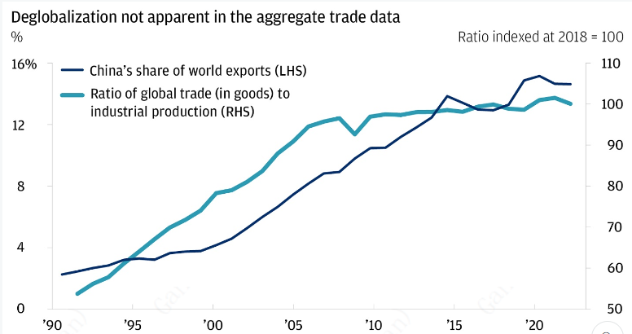
Since China was at the center of the trade tensions beginning in 2018, one would expect to see China’s share of global trade declining if the world were de-globalizing. Yet China’s share of global exports is up. Also up: the ratio of global trade in goods to global industrial production

Slide 5
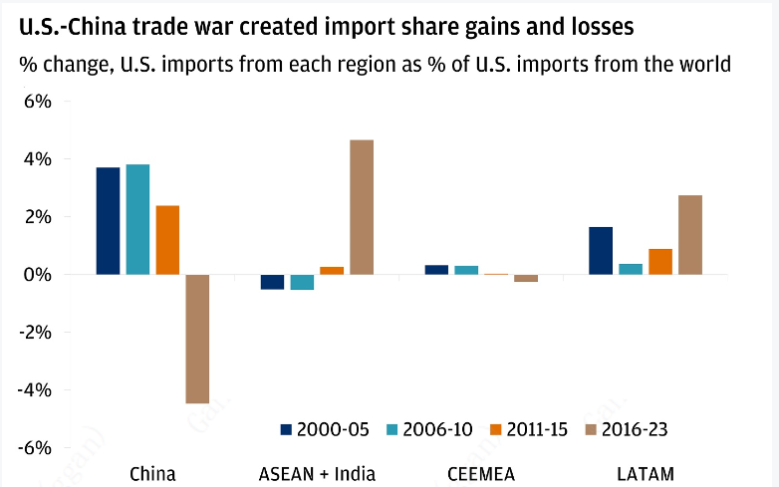
Once the U.S. imposed tariffs on about 66% of imports from China as part of the trade war, the locality of trade shifted markedly. While China’s share of U.S. imports declined from 2016 to 2023, those declines were offset by gains made by member nations of the Association of Southeast Asian Nations (ASEAN), and by India and countries in Latin America. (The nations of Central and Eastern Europe, the Middle East and Africa [CEEMEA] did not see U.S. trade share gains in this period.)

Slide 6
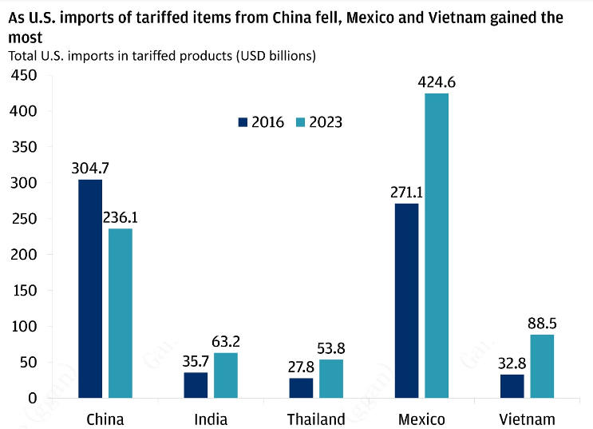
U.S. imports of tariffed items from China fell by about $70 billion. As that occurred, our analysis shows, Vietnam saw the largest percentage gain in exports of tariffed items: a rise of 170%. But Mexico has seen the largest gains in USD terms, at more than $153 billion. The most significant of those exports: semiconductors and related electronic components; auto parts; and other items that were hit by 25% tariff rates imposed on China, such as oils obtained from bituminous minerals.

Slide 7
Globalization is intact
Globalization remains intact, despite several large shocks in recent years. Its preservation is a testament to the flexibility of manufacturing supply chains globally. Multinational corporations have shown they can quickly adapt to new policies and pivot around heightened geopolitical risks. This flexibility has helped corporate profit margins maintain the historic gains that were made in recent decades due to globalization.

